Slide 1
Finger Biometric Technologies

Slide 2
Introduction
Fingerprint biometrics are the most widely used and accepted of all the biometrics.
Fingerprints are identified by both macro and micro features.
The macro features of a fingerprint include:
Ridge patterns
Ridge pattern area
Core point
Delta point
Type lines
Ridge count

Slide 3
Introduction
Fingerprints are identified by both macro and micro features.
The micro features of a fingerprint are made up of minutia points. Minutia points are classified by:
Type
Orientation
Position

Slide 4
Introduction
In the biometric process of finger scanning, minutiae are specific points in a finger image.
The number and locations of the minutiae vary from finger to finger in any particular person, and from person to person for any particular finger (for example, the thumb on the left hand).

Slide 5
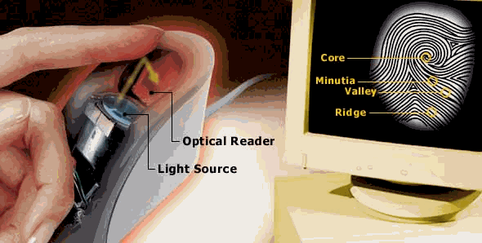
IMAGE ACQUISITON

Slide 6
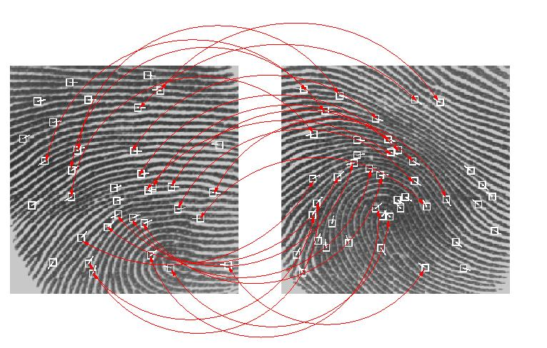
MINUTIA MATCHING

Slide 7
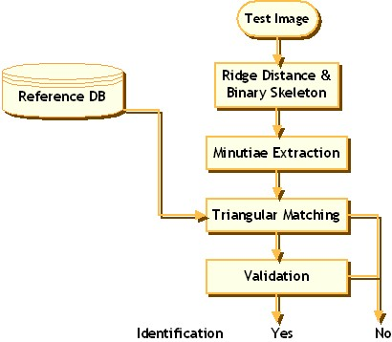
PROCESS

Slide 8
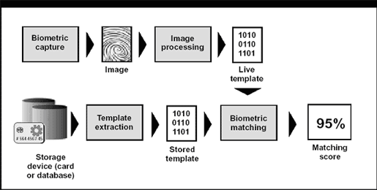
PROCESS

Slide 9
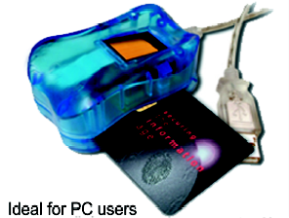
FINGERPRINT PC LOCK

Slide 10
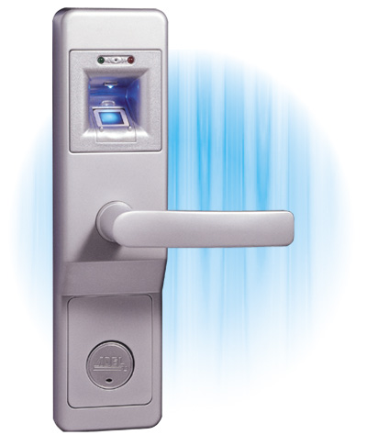
FINGERPRINT DOOR LOCK

Slide 11
Macro Fingerprint Features
Macro fingerprint features are, as the name implies, large in size.
A feature is considered macro if it can be seen unaided by the human eye.
The most visible macro feature seen is the ridge pattern.

Slide 12
Macro Fingerprint Features
Ridge Pattern
Arch Arches account for approximately 5% of the ridge pattern in a given population. Arches are different from loops in that arches are more open curves.
Loop Loops account for approximately 60% of the ridge patterns in a given population.
Loops may slant left or right, or be presented as a double loop.

Slide 13
Macro Fingerprint Features
Whorl Whorls account for approximately 35% of the ridge patterns in a given population.
Whorls are defined by at least one ridge making a complete circle.

Slide 14
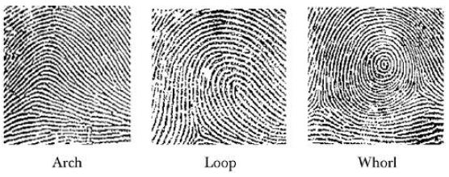
Macro Fingerprint Features

Slide 15
Macro Fingerprint Features
Arch: The ridges enter from one side of the finger, rise in the center forming an arc, and then exit the other side of the finger.
Loop: The ridges enter from one side of a finger, form a curve, and then exit on that same side.
Whorl: Ridges form circularly around a central point on the finger.

Slide 16
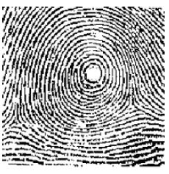
Macro Fingerprint Features
The core point is found at the center of the finger image.
It is used as a reference point for measuring other minutia and also during classification.

Slide 17
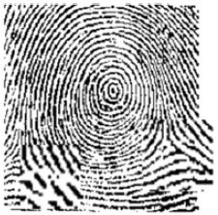
Macro Fingerprint Features
Delta point is triangular shaped pattern where different fingerprint ridges meet.

Slide 18
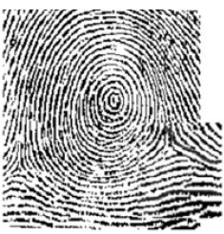
Macro Fingerprint Features
Type lines are the two parallel innermost ridges that define the ridge pattern area.

Slide 19
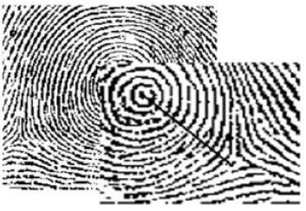
Macro Fingerprint Features
Ridge count is the number of ridges that intersect a line drawn from a delta to the core.
There could be more than one ridge count for each finger image.

Slide 20
Micro Fingerprint Features
As the name implies, micro fingerprint features cannot be seen unaided by the human eye.
A number of the current fingerprint scanners on the market now have a high enough resolution that pores can be counted.

Slide 21
Micro Fingerprint Features
What follows is a description of the minutia that make up the micro features:
Type
Orientation
Spatial frequency
Curvature
Position

Slide 22
Micro Fingerprint Features
Type
There are a number of different types of minutia; the common ones are:
Ridge ending
Ridge bifurcation
Ridge divergence
Dot or island
Enclosure or lake
Short ridge

Slide 23
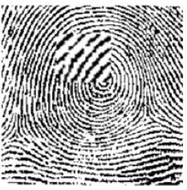
Micro Fingerprint Features
Ridge ending
A ridge ending is a gap in a ridge or a point where a ridge suddenly stops

Slide 24
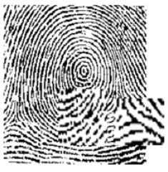
Micro Fingerprint Features
Ridge bifurcation
A ridge bifurcation occurs when a ridge splits into two or more new ridges

Slide 25
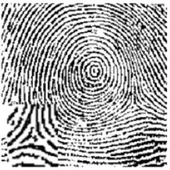
Micro Fingerprint Features
Ridge divergence
A ridge divergence occurs when two ridges running parallel suddenly diverge in opposite directions.

Slide 26
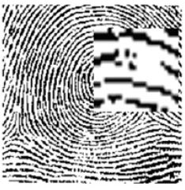
Micro Fingerprint Features
Dot or island
A dot or island occurs when a ridge is short enough to be perceived as a single point (dot) or straight line (island).

Slide 27
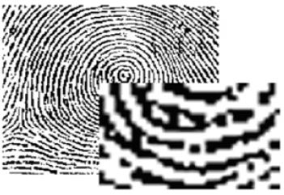
Micro Fingerprint Features
An enclosure (lake) minutia occurs when a ridge bifurcates and then rejoins itself.
This then leaves a valley surrounded by the rejoined ridge.

Slide 28
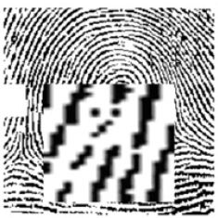
Micro Fingerprint Features
Short ridge
A short ridge is a ridge of short length, but not so short as to be considered an island or dot.

Slide 29
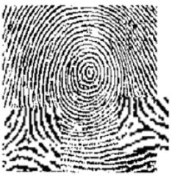
Micro Fingerprint Features
Orientation
Orientation refers to the general direction in which a minutia feature appears to be moving.

Slide 30
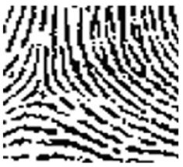
Micro Fingerprint Features
Spatial frequency
Spatial frequency can be viewed as the density of ridges around a given minutia point.
In this case, the spatial frequency is higher around the island at the top right than the bifurcation at the middle left.

Slide 31
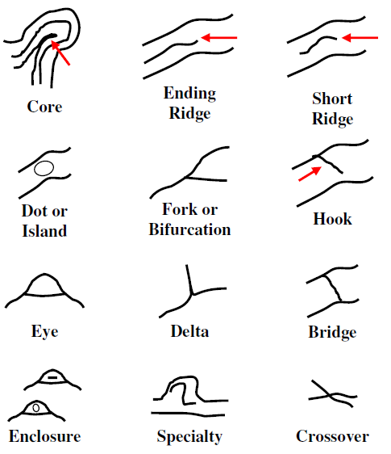
Micro Fingerprint Features

Slide 32
Micro Fingerprint Features
Curvature
Curvature is the rate of change of a ridge's direction.
In the above left enlargement in Figure, the rate of change is lower, as the ridge curves are flatter.
In the bottom right enlargement in Figure, the rate of change is higher, as the ridge curves are tighter.

Slide 33
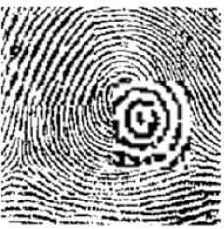
Micro Fingerprint Features
Curvature

Slide 34
Micro Fingerprint Features
Position
Position refers to the relative location of the minutia. References are normally made using a grid, and having the origin either at the core point or at a delta.
In example, you can find a bifurcation at (1,-1) and a group of dots at (-1,1.5)

Slide 35
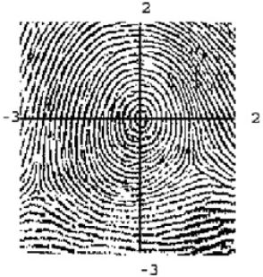
Micro Fingerprint Features

Slide 36
How Is the Finger Imaged?
Since fingerprint biometrics are active biometrics, the user must submit to the scan and needs to place his/her finger on the scanner for imaging.
The technology used to scan fingers falls into two basic categories:
Optical scanners
Silicon scanners

Slide 37
How Is the Finger Imaged?
Optical scanners are composed of complementary metal-oxide semiconductor (CMOS) and charge-coupled device (CCD) technology.
Silicon scanners include capacitive, thermal, and radio frequency (RF).

Slide 38
Types of Algorithms Used for Interpretation
Now that we know what constitutes a fingerprint and how it can be imaged, we need to know which types of algorithms are used.
The algorithms used to match and enroll fingerprints fall under the following categories:
Minutia-based
Pattern-based
Hybrid algorithm

Slide 39
Minutia-based
For minutia-based fingerprint algorithms, only a small part of the finger image is required for verification.
Since just a portion of the minutia is required for verification, it would be ideal to use this algorithm where space restrictions impact the use and deployment of biometrics

Slide 40
Pattern-Based Algorithm
Pattern-based matching algorithms use both the micro and macro features of a fingerprint.
A good imager for pattern-based matching algorithms is one that has a high-quality camera and a large enough scanning surface to capture the important macro details.

Slide 41
Hybrid Algorithm
As the name implies, a hybrid algorithm uses the best features from the minutia based algorithms and those from pattern-based matching.
Which Algorithm Is Best?
With the right conditions, the pattern-based algorithm and minutia based algorithm perform equally well.

Slide 42
How Can this Biometric be Spoofed?
Attacks on a finger biometric system fall into the following categories:
Attacking the physical finger
Using artifacts
Attacking the communications
Compromising the template

Slide 43
How Can this Biometric be Spoofed?
Attacking the Physical Finger
This is the type of attack that gets the most press.
We have all seen this in the movies, where the hero or villain fakes someone's fingerprints.
Making a fake finger is not easy. but with right knowledge and the appropriate material like gelatin, silicon ,latex ,a fake finger can be created.

Slide 44
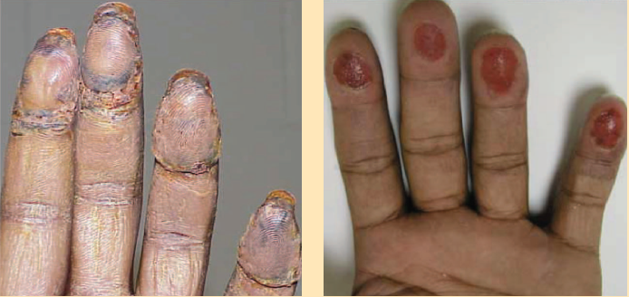
How Can this Biometric be Spoofed?
Transplanted skin Bitten fingertips

Slide 45
How Can this Biometric be Spoofed?
Using Artifacts
Artifact use on capacitance scanners normally involves tricking the scanner into thinking a finger is present.
The sensor images are based on a sufficient change in capacitance.
This change in capacitance is normally accomplished in the finger through its moisture content.

Slide 46
How Can this Biometric be Spoofed?
To duplicate this with an artifact, an attacker could breathe or blow across the surface of the imager, or use a thin-walled plastic bag with water in it laid on the imager.
Attacking the Communication Channels
If an attacker cannot compromise a system at the point of collection, the next logical spot to compromise is the communication path.
If the information being transmitted could be changed so that a false positive or a false rejection occurs, the attacker has succeeded.

Slide 47
How Can this Biometric be Spoofed?
Compromising the Template
Moving up the attack food chain, if the capture and communications of the comparison template prove to be impossible, then a compromise of the stored reference template might be attempted.

